Slide 1
Hyper Text Markup Language (HTML)
An Introduction

Slide 2
What is HTML
HTML is used for formatting the web page.
HTML uses markup for formatting .
<b> Show it in Bold </b>
These markups are also known as tags.
All tags start with < (less than symbol) and end with > (grater than symbol )
Tags that ends has one extra “/ “ symbol

Slide 3
Some Tags
Sample Tags
<HTML>, <BODY>, <TITLE>
</HTML>, </BODY>, </TITLE>
Starting tags / elements
Ending tags / elements

Slide 4
Sample HTML
<HTML>
<HEAD>
<TITLE>This is My Page </TITLE>
</HEAD>
<!- - Created for GPS summer training - - >
<BODY>
This is the web page
</BODY>
</HTML>

Slide 5
Open and Closed tag
Kinds of Tags
1.
Range / Container tags
They are called so because they cover a range of text.
Example : <HTML>, <HEAD>, <BODY>, <TITLE>
2.
Standalone / Point tags
Those tags which do not need an ending.
Example: <HR>, <BR>
Notes:
<HR> tag is used for drawing a horizontal line. And <BR> tag is used to give a line break. Discussed later in more detail later.

Slide 6
Some Useful tags
<B> - To mark a text bold.
<I> - To make a text italic.
<U> - To underline a text.
<FONT> - Used for basic application of font properties like font size, font face, font color.
<marquee> - To scroll a text.
<img> - To insert an image in an HTML page.
<SOUND> - To insert an media file in an HTML page.
<OL>,<UL> - For creating a ordered and unordered list respectively.
<A> - Used for Hyperlinking (Internal as well as External linking)

Slide 7
Commonly Used Tags
<P> - Starts a new paragraph.
<HR> - Draw a horizontal rule.
<BR> - Forces a line break.
<!-- This is a comment entry --> - Used For Comment entry in HTML.
<H1> … <H6> - Different levels of heading tags.
<ins> - It defines a inserted text.
<sub> - Defines subscripted text.
<sup> - Defines superscripted text.

Slide 8
The Heading Tags
To add headings in the HTML document use <Hn> tag where, n represent number from 1 to 6.
Some text here
<H1>
</H1>
<H2>
Some text here
</H2>
<H3>
Some text here
</H3>
<H4>
Some text here
</H4>
<H5>
Some text here
</H5>
<H6>
Some text here
</H6>
Notes:
All the different levels of Headings tag has align as an attribute with “LEFT”, “RIGHT”, “CENTER” as values.

Slide 9
Listing In HTML
A common applications of HTML is to display the list of items.
The most popular types of lists that can be created using HTML are:
Unordered List
Ordered List
Notes:
List can also created using Definition List tags.
The definition list tag, or <DL>, can be used to define a definition. It is commonly used to describe items found in a glossary. The definition list is made up of a term, <DT>, and followed by one or more definition descriptions <DD> items.

Slide 10
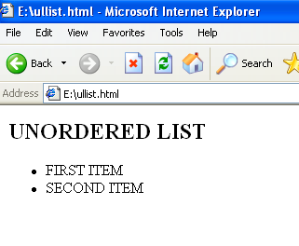
Unordered List
<HTML>
<BODY>
<H2>UNORDERED LIST</H2>
<UL>
<LI>FIRST ITEM</LI>
<LI>SECOND ITEM</LI>
</UL>
</BODY>
</HTML>

Slide 11
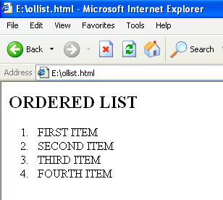
Ordered List
<HTML>
<BODY>
<H2>ORDERED LIST</H2>
<oL>
<LI>FIRST ITEM</LI>
<LI>SECOND ITEM</LI>
<LI>THIRD ITEM</LI>
<LI>FOURTH ITEM</LI>
<oL>
</BODY>
</HTML>

Slide 12
Using Links
The Anchor Tag
HTML uses the <a> (anchor) tag to create a link to another document.
Attributes of <a>(anchor) tag
href : is used to address the document to link to, and the words between the open and close of the anchor tag will be displayed as a hyperlink.
Syntax:
<a href=”url”>Text to be displayed</a>
Notes:
The <a> tag is used to create an anchor to link from, the href attribute is used to address the document to link to, and the words between the open and close of the anchor tag will be displayed as a hyperlink.

Slide 13
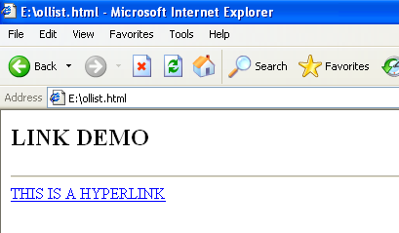
Link Demo
<HTML>
<BODY>
<H2>LINK DEMO</H2>
<HR>
<A HREF="tgt.html">THIS IS A
HYPERLINK</A>
</BODY>
</HTML>

Slide 14
HTML Table
Table allows to organize and present data in an orderly and concise manner.
Tabular structures were introduces with HTML 3.2.
A table can contains wide variety of information, such as headers, anchors, lists, paragraphs, forms, images, preformatted text and even nested tables.
HTML tables are composed of rows and columns.
Notes:
Prior to HTML 3.2, <PRE> tag were used to create table like structure.

Slide 15
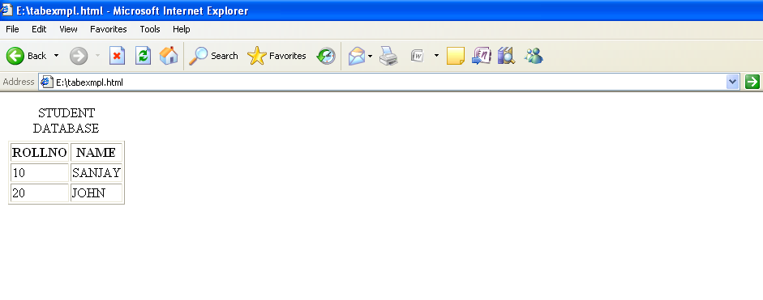
Table

Slide 16
<TABLE> tag
<TABLE BORDER=“1”>
<CAPTION>STUDENT DATABASE</CAPTION>
<TR>
<TH>ROLLNO</TH>
<TH>NAME</TH>
</TR>
<TR>
<TD>10</TH>
<TD>SANJAY</TD>
</TR>
<TR>
<TD>20</TH>
<TD>JOHN</TD>
</TR>
</TABLE>

Slide 17
HTML Form
Till now web page was used only to display information.
No interactivity with user
With the help of <form> tag , web page is now interactive.
Data entry screen can be created , through which user can insert as well as edit data.
By HTML form , data can be accepted by browser then data are sent across the internet to web server for processing.
Some validation related code can be written using a scripting language like , JavaScript

Slide 18
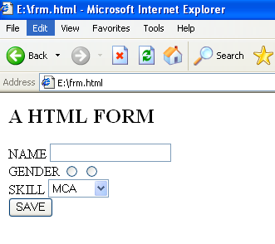
HTML Form Demo

Slide 19

HTML Form Demo
Program to process data submmitted through form
Client (Browser)
Web Server

Slide 20
Processing FORM
Data submitted through every FORM is processed by a program , that runs in web server.
This program has a name (URI)
This name is mentioned in “action” attribute of the FORM tag
<FORM ACTION=“serverside program name”>
</FORM>

Slide 21
HTML Form Code
<HTML>
<BODY>
<H2> A HTML FORM </H2>
<FORM>
NAME <INPUT TYPE="TEXT" NAME="NAME" /><BR>
GENDER <INPUT TYPE="RADIO" NAME="R1" VALUE="M" />
<INPUT TYPE="RADIO" NAME="R2" VALUE="F" /><BR>
SKILL <SELECT NAME="S">
<OPTION VALUE="MCA">MCA</OPTION>
<OPTION VALUE="MCA">MBA</OPTION>
<OPTION VALUE="BTECH">BTECH</OPTION>
</SELECT><BR>
<INPUT TYPE="SUBMIT" VALUE="SAVE" />
</FORM>
</BODY>
</HTML>

Slide 22
HTML Form Demo
<input type=“text” name=“name” />

